Slide 2

2
5
Lesson 25
Probability III-Geometric Probability & Expected Value

Slide 3
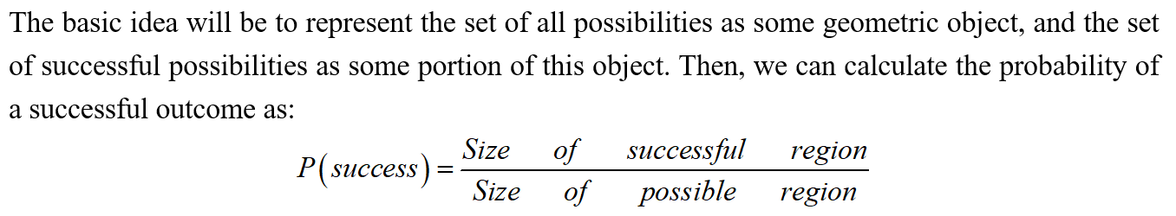
Lead in

Slide 4
Chapter 1
Probability Using Lengths

Slide 5
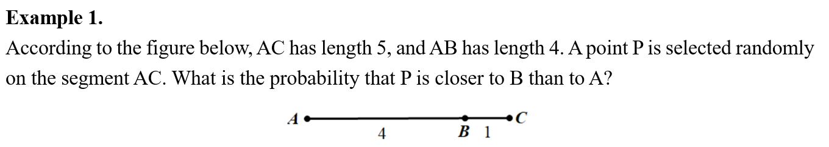
Example

Slide 6
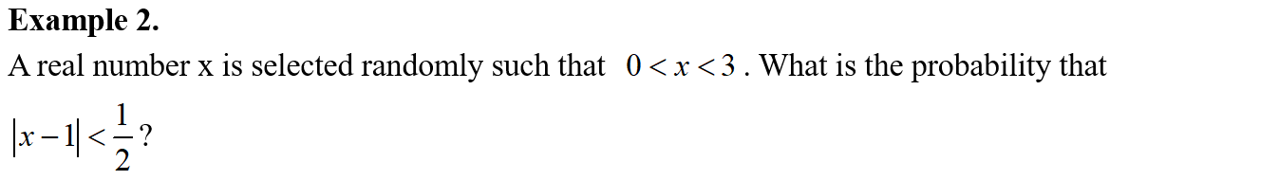
Example

Slide 7
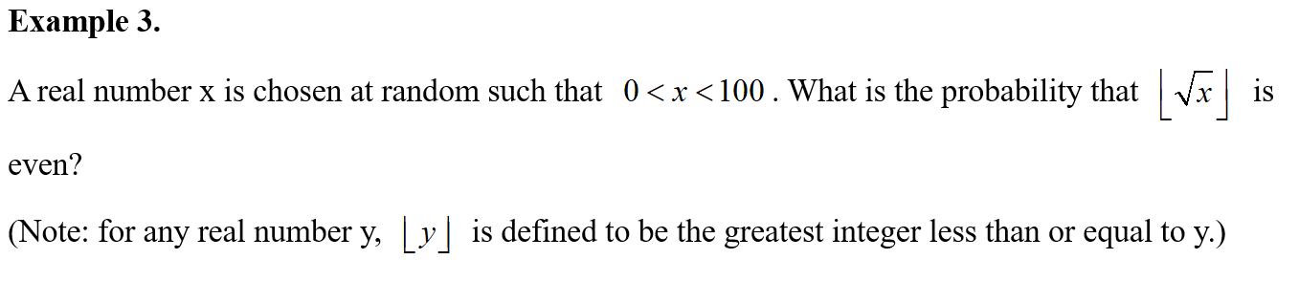
Example

Slide 8
Chapter 2
Probability Using Areas

Slide 9
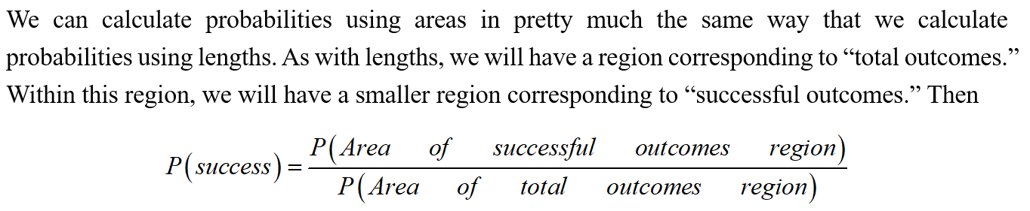
Lead in

Slide 10
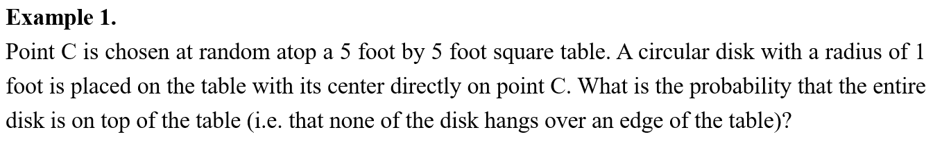
Example

Slide 11
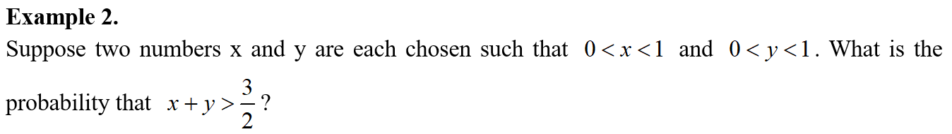
Example

Slide 12
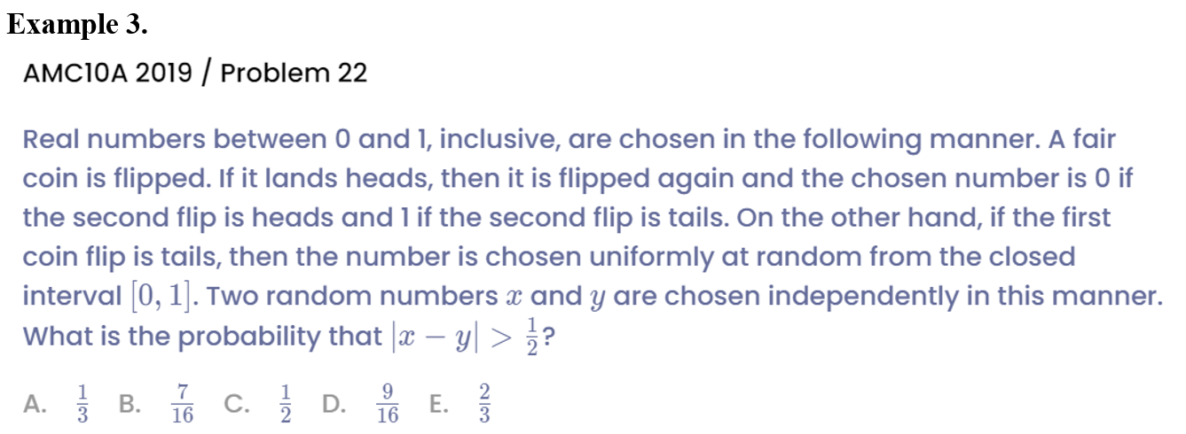
Example

Slide 13
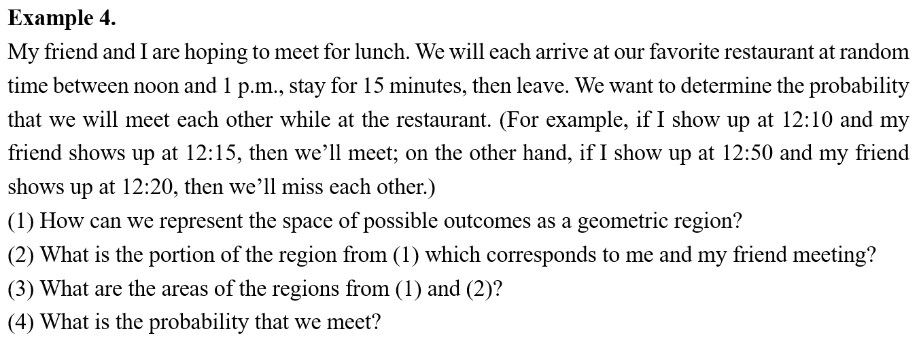
Example

Slide 14
Chapter 3
Expected Value

Slide 15
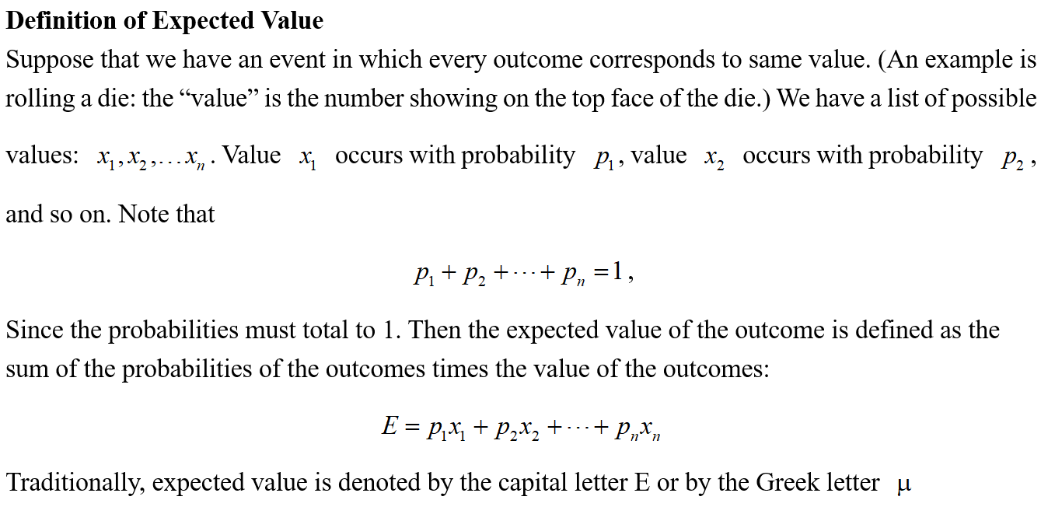
Lead in

Slide 16
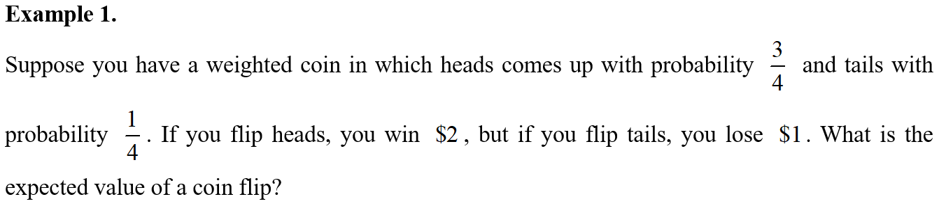
Example

Slide 17
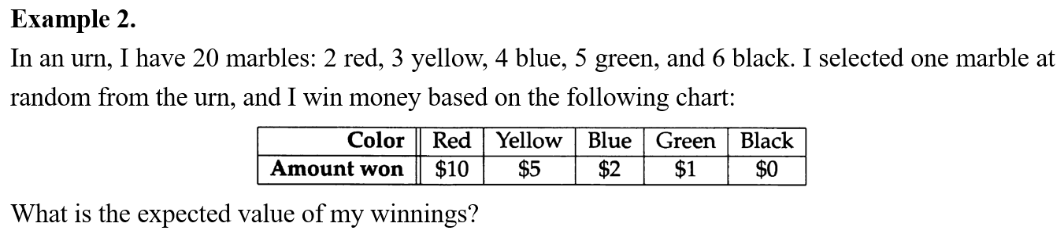
Example

Slide 18
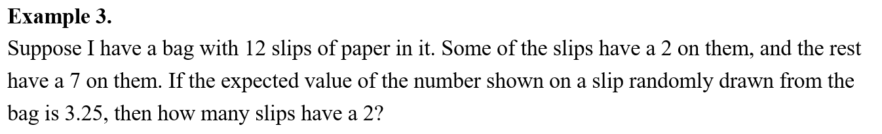
Example

Slide 19
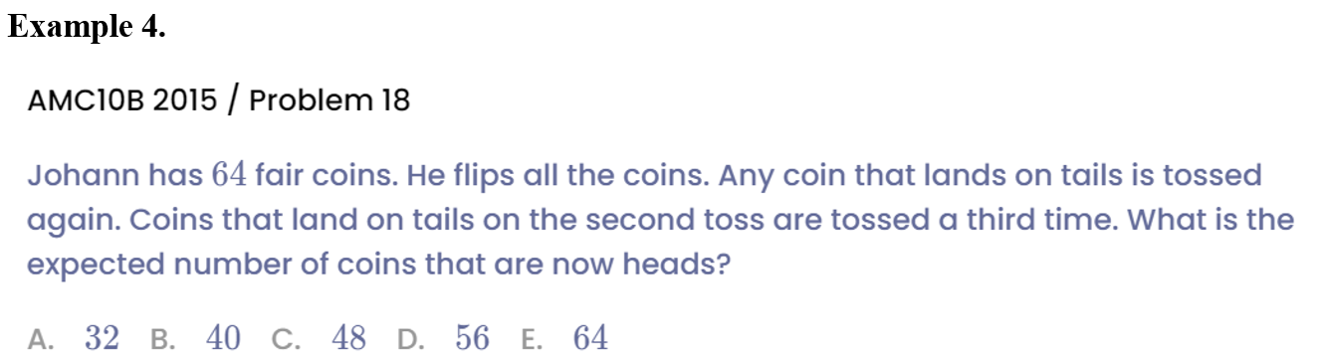
Example

Slide 20
Chapter 4
Comprehensive Problem

Slide 21
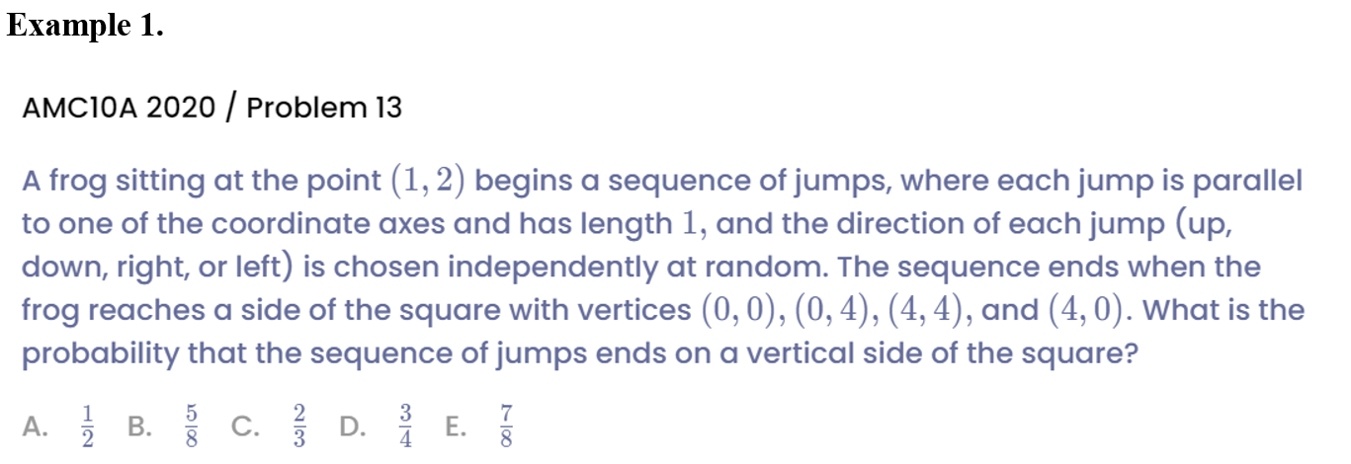
Example

Slide 22
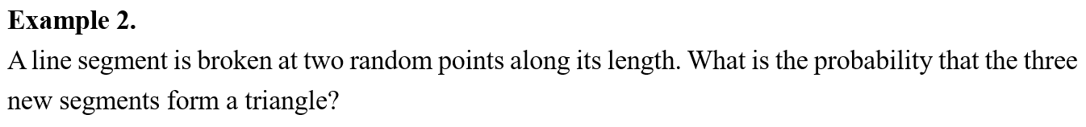
Example

Slide 23
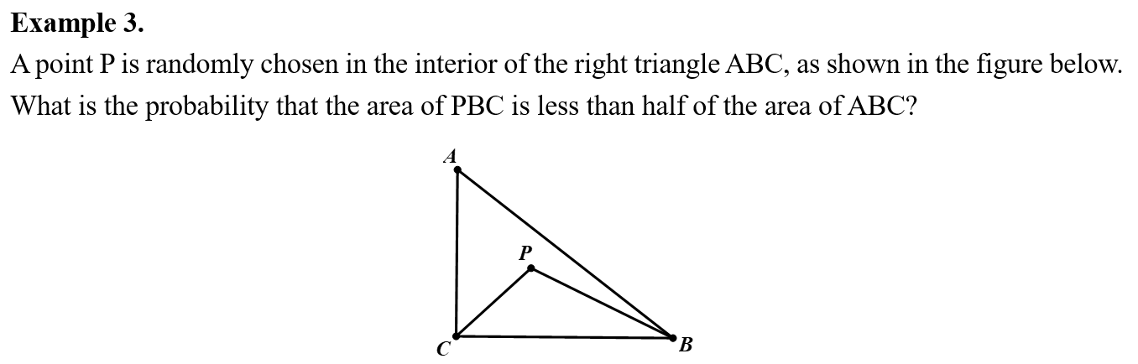
Example

Slide 24
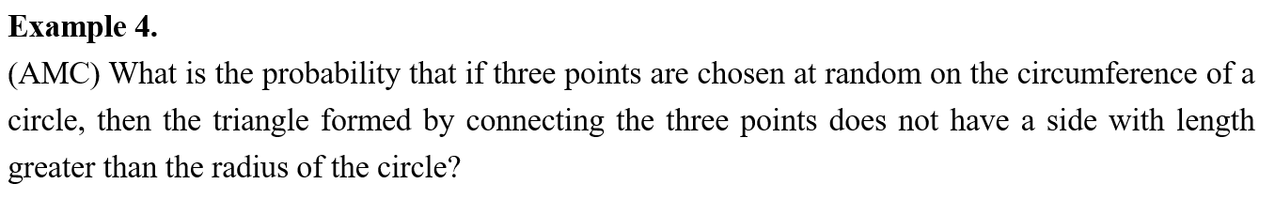
Example

Slide 25
Chapter 5
Challenge Problem

Slide 26
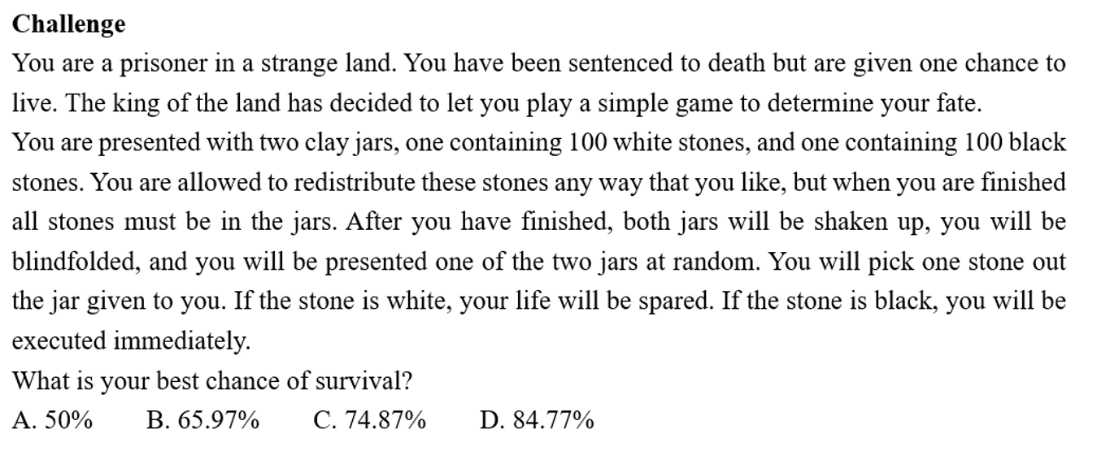
Example

Slide 27
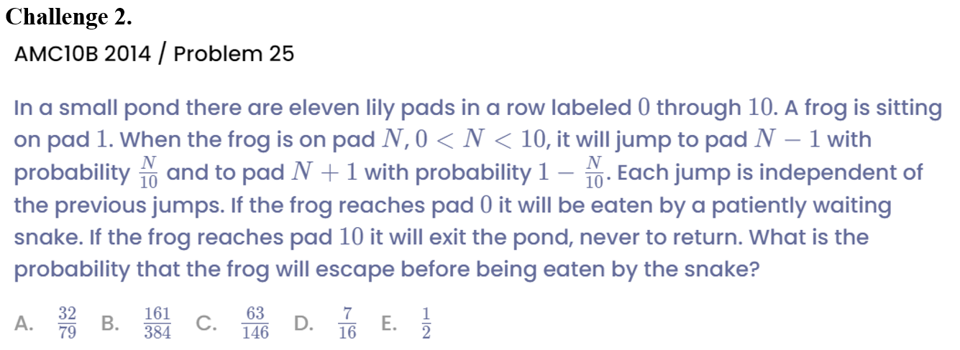
Example

Slide 28
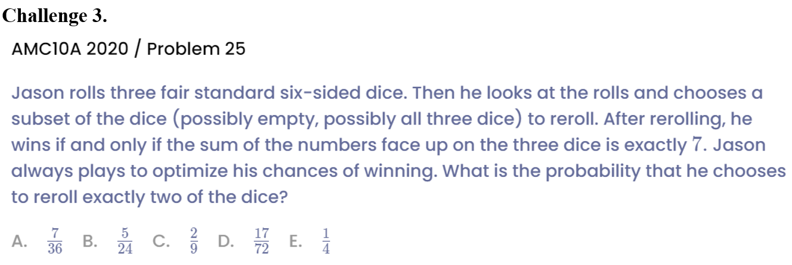
Example

Slide 29
See You Next Time!

